Slide 1
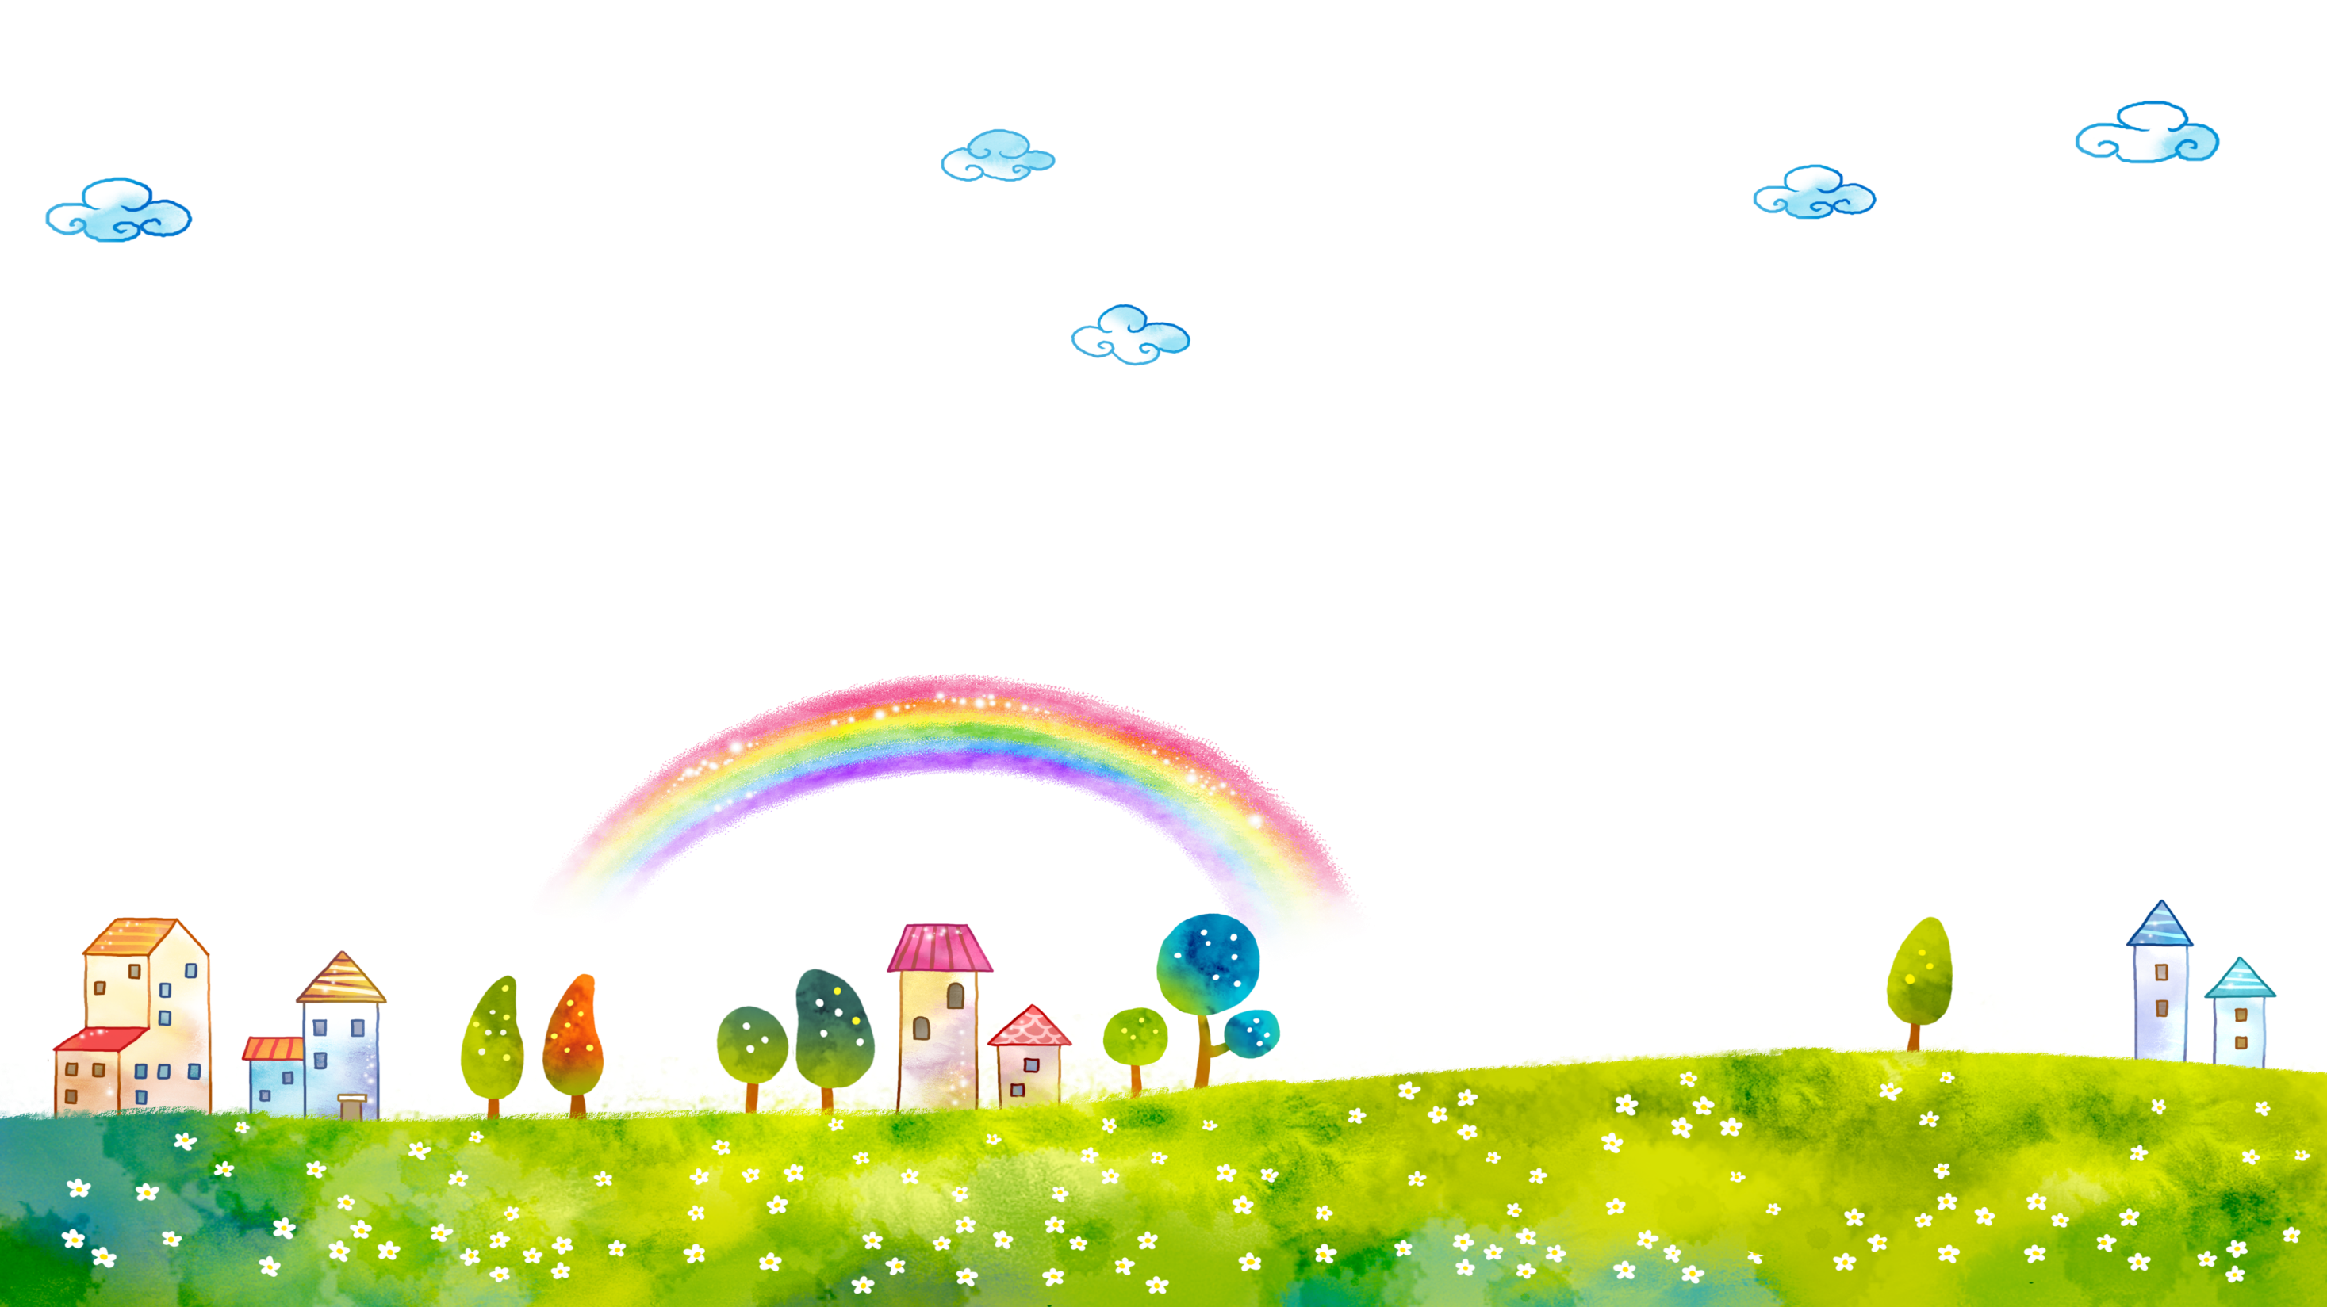
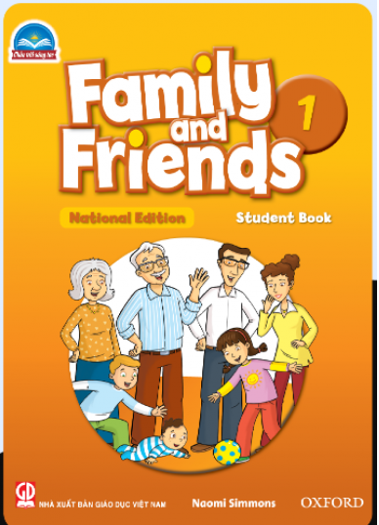
FAMILY and FRIENDS 1
National Edition

Slide 2
Unit 1: What color is it?
Lesson 3 SOUND and LETTER

Slide 3
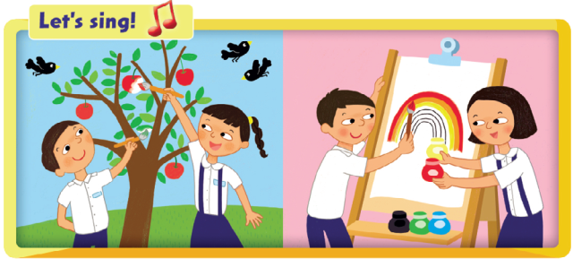

Slide 4
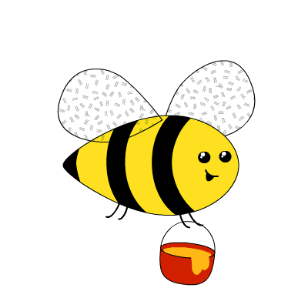
What flower does the bee like ?
blue

Slide 5
What flower does the bee like ?
black

Slide 6
What flower does the bee like ?
green

Slide 7
What flower does the bee like ?
red

Slide 8
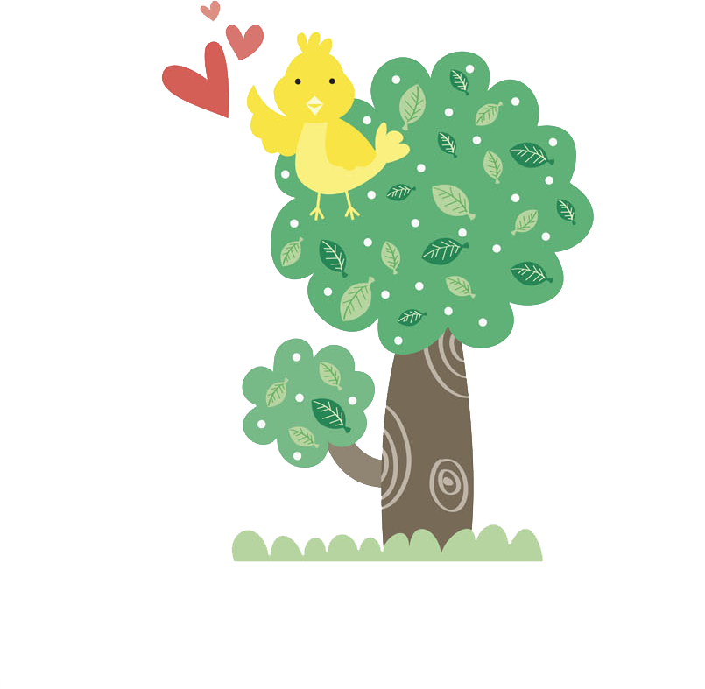
Notes:
- Show students the uppercase C and lowercase c.
- Say the sound /k/. Ask students to repeat.
- Draw dotted outlines of the uppercase C and lowercase c on the board.
- Ask different students to come to the board and connect the dots.

Slide 9
Notes:
Listen, point, and repeat. Write. Track 19
- Play track 08, listen and point
- Play again, ask students to listen and point
- Play again, ask students to listen and repeat
- Model the writing activity

Slide 10
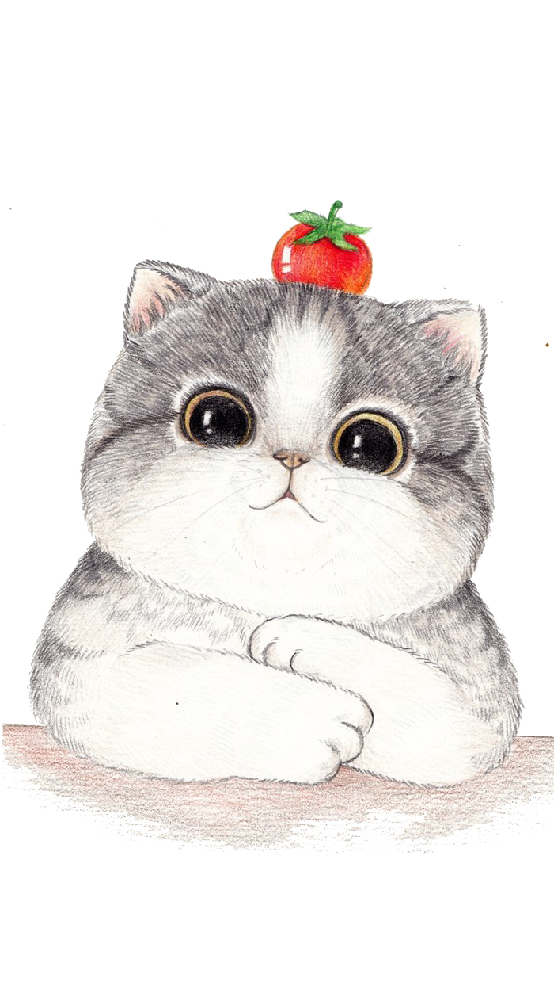
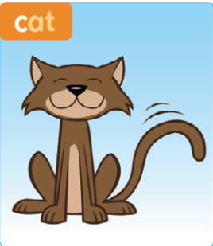
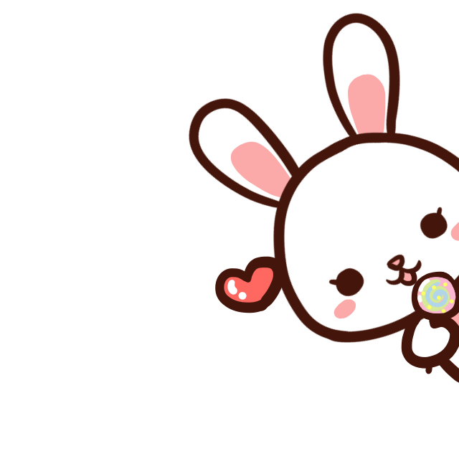
c
Notes:
Listen and repeat

Slide 11
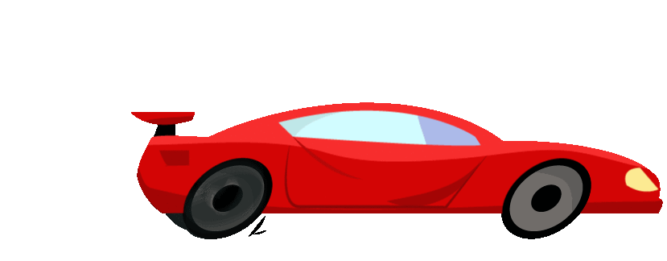
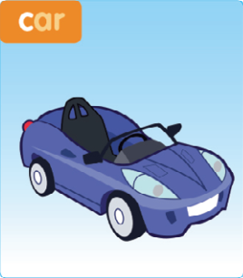
c
Notes:
Listen and repeat

Slide 12
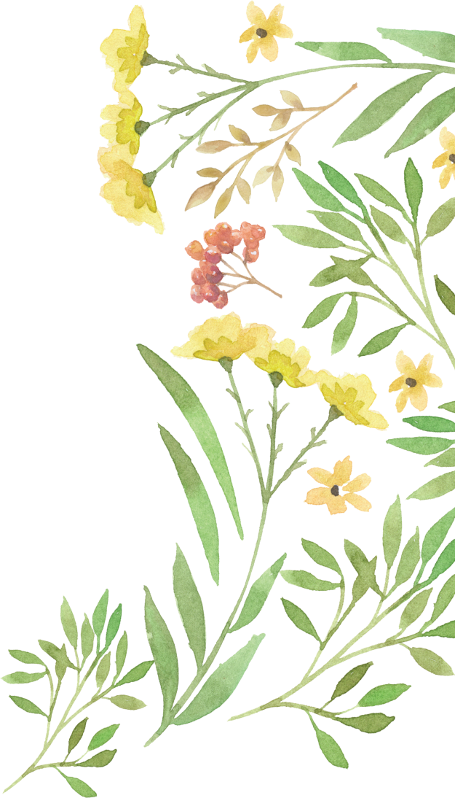
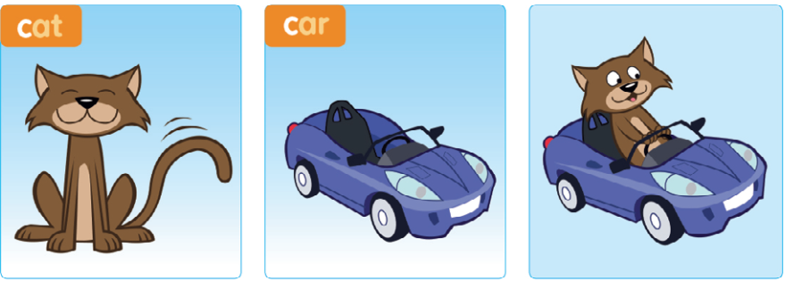
Notes:
2. Listen and chant: track 20
- Point to the picture and say: “A cat in a car.”
- Play the recording, ask students to listen to the chant.
- Put Phonics cards 5-6 in different places around the room.
- Play the chant again
- Students point to the cards.
- Play the chant again, pause for students to repeat.
• Below level:
- Divide the class into two groups: “cat” and “car.”
- Play the chant again. Each group should stand up and sit down again when they hear their word.
• At level:
- Divide the class into two groups: “cat” and “car.”
- Play the chant again.
- When the ‘cats’ hear the word cat, they pretend to be a cat stroking its ears with its paws. When the ‘cars’ hear the word car, they pretend to drive, using their hands on the steering wheel.
- Switch groups and repeat.
• Above level:
- Students do both mimes for the ‘cat’ and the ‘car’.
- Students draw the letter c in the air when they hear the /k/ sound each time.

Slide 13
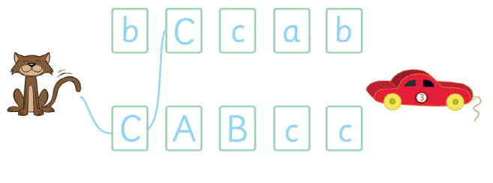
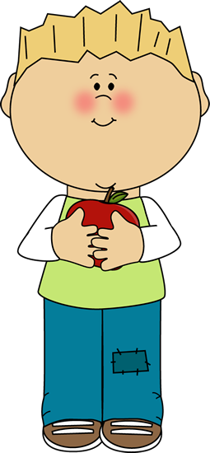
Point to the letter Cc
Notes:
3. Connect the letter Cc. Stick and say.
- Say Let’s connect the letters!
- Connect line in blue, saying /k/ at each letter.
- Next, point to the letter c and the letter C and ask the children: Is it /k/?
- Say Now it’s your turn!
- Ask students to connect and say.
- say Let’s stick! Hold up the c sticker and model placing it in the book in the correct position, while saying /k/.

Slide 14
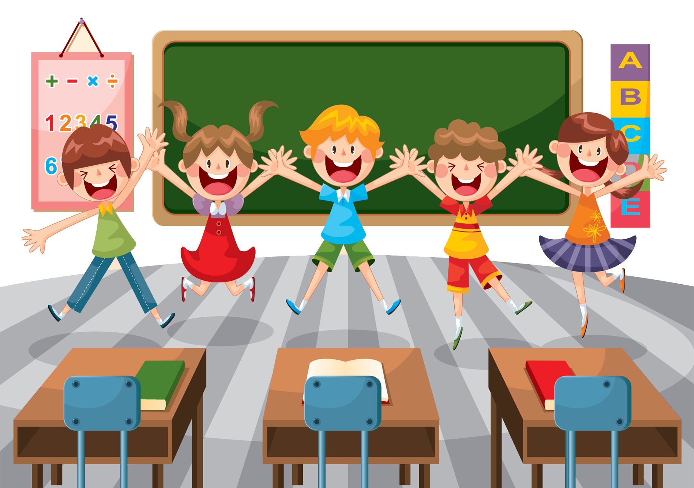
Goodbye !

